Slide 1

Fake News detection using machine learning
Anirudh pandey
2018165
Ritesh bisht
2018642

Slide 2

Introduction
Objective – To develop a machine learning model that can distinguish between fake and real news article.
Importance – Fake News can have significant negative impacts on society, influencing public opinion, and causing misinformation. Detecting and mitigating fake news is essential in maintaining the integrity of information disseminated online.

Slide 3

Data collection
Datasets:
Fake.csv: Contains examples of fake news articles.
True.csv: Contains examples of real news articles.
Source: The datasets were obtained from Kaggle, a well-known platform for datasets and machine learning competitions.
This Photo by Unknown Author is license unCC BY-NC-ND

Slide 4

Data preparation
Labeling:
Fake news: Labeled as 0
Real news: Labeled as 1
Combining Datasets: Merged both datasets into a single dataframe and dropped any unnecessary columns to streamline the data.

Slide 5

Data Cleaning
Preprocessing Steps:
Converted all text to lowercase.
Removed special characters, URLs, HTML tags, punctuation, and numbers.
Purpose:
These steps ensure data consistency and prepare the text for vectorization and further analysis.

Slide 6

Feature extraction
TF-IDF Vectorization:
Explanation: TF-IDF stands for Term Frequency-Inverse Document Frequency. It is a statistical measure used to evaluate the importance of a word in a document relative to a collection of documents.
Usage: It converts the textual data into numerical features that can be used by machine learning algorithms.

Slide 7
MODEL SELECTION
Logistic Regression: Logistic regression is a supervised machine learning algorithm used for classification tasks where the goal is to predict the probability that an instance belongs to a given class or not. Logistic regression is a statistical algorithm which analyze the relationship between two data factors.
Random Forest Classifier: Random Forest algorithm is a powerful tree learning technique in Machine Learning. It works by creating a number of Decision Trees during the training phase. Each tree is constructed using a random subset of the data set to measure a random subset of features in each partition. This randomness introduces variability among individual trees, reducing the risk of overfitting and improving overall prediction performance. In prediction, the algorithm aggregates the results of all trees, either by voting (for classification tasks) or by averaging (for regression tasks) This collaborative decision-making process, supported by multiple trees with their insights, provides an example stable and precise results. Random forests are widely used for classification and regression functions, which are known for their ability to handle complex data, reduce overfitting, and provide reliable forecasts in different environments.

Slide 8
Splitting the data
Training and Testing Sets: Used the train_test_split method from Scikit-Learn to split the data into training and testing sets, with 75% of the data used for training and 25% for testing.

Slide 9
Model training
The process of training and testing machine learning models for fake news detection involves several critical steps. First, the dataset was divided into training and testing sets to evaluate the model's performance on unseen data. Typically, an 80-20 split was used, with 80% of the data used for training the models and 20% for testing. Both Logistic Regression and Random Forest models were trained using the preprocessed and feature-engineered dataset.
Performance was evaluated on the test set using several key metrics:
Accuracy: The overall correctness of the model's predictions.
Precision: The accuracy of positive predictions (i.e., correctly identifying fake news).
Recall: The model's ability to identify all actual fake news articles.
F1 Score: A balance between precision and recall, providing a single measure of performance.

Slide 10

Mannual testing function
Functionality: Describe the manual_testing function, which allows for inputting new articles, preprocessing the text, transforming it using TF-IDF, and making predictions using the trained models.
For the purpose of manual testing, we selected 10 columns and 10 rows from both the true.csv and fake.csv datasets. After concatenating these samples, we saved the combined data into a new CSV file designated for manual testing. This approach ensures a balanced representation of both fake and real news articles, facilitating an effective evaluation of our model's performance on a smaller, controlled subset of the data.

Slide 11
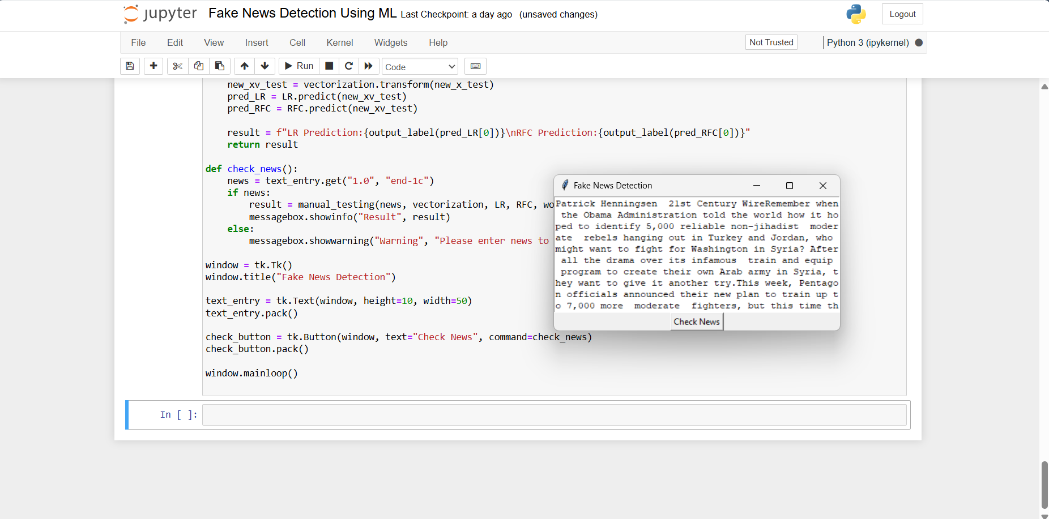
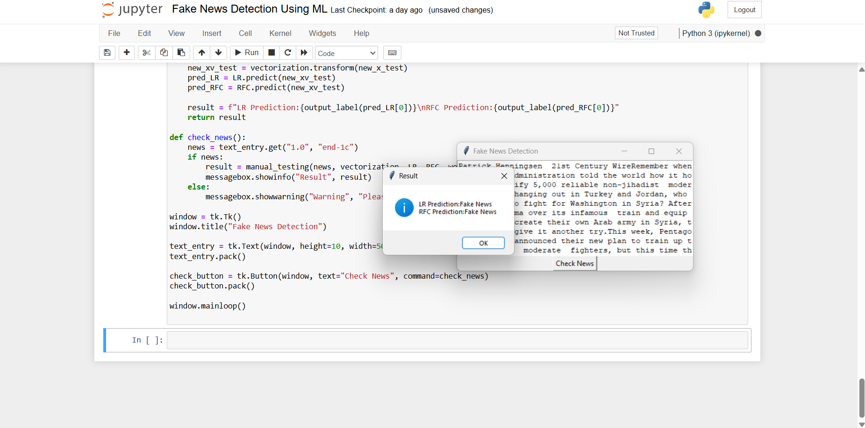
Snapshots

Slide 12
Challenges and improvements
Challenges: Handling and preprocessing large amounts of text data. Selecting appropriate models and fine-tuning hyperparameters for optimal performance.
Future Work: Implementing advanced NLP techniques such as word embeddings and deep learning models like BERT. Enhancing the dataset in terms of diversity and size to improve model robustness.

Slide 13
THANK YOU

